Slide 1
Ecosystem Response to
Climate Change:
Assessment of Effects and
Adaptation Strategies
Laura Gadd
NC Department of Environment and Natural Resources
Natural Heritage Program
November 17, 2010

Slide 2
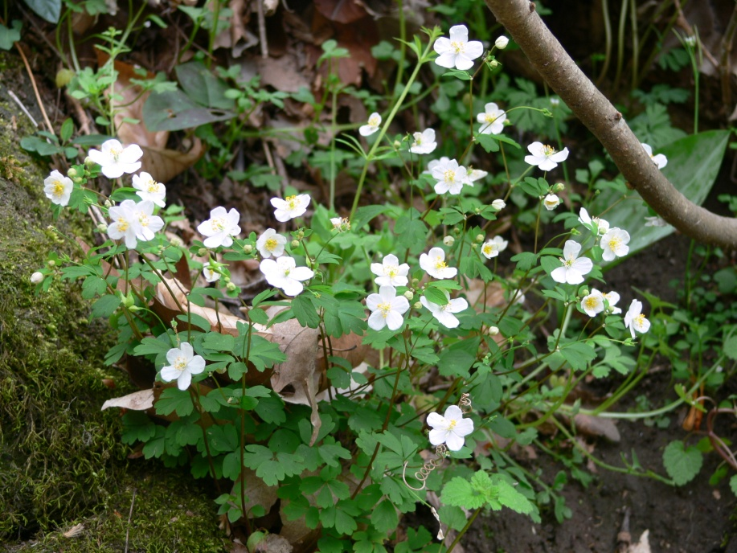
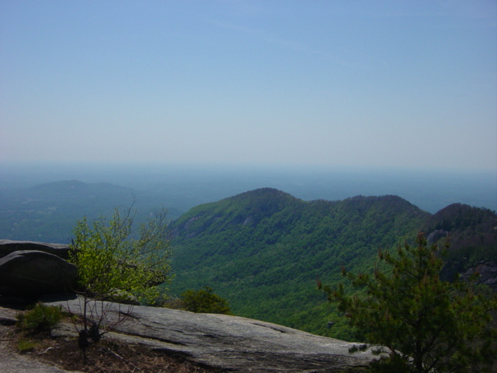
NC Natural Heritage Program
Founded in 1976
Part of an international network
Funded through the Natural Heritage Trust Fund grant
Partnership focus
Non-regulatory
Notes:
part of Dept. Env & Nat Res. And the states One NC Naturally initiative
Founded with LWCF planning grant. Staff of 4 Coord., Botanist, Protection Spec., Zoologist & Data Manager
Member of NatureServe
Biotics – struggling to change 20,000 records
Member of NatureServe.

Slide 3
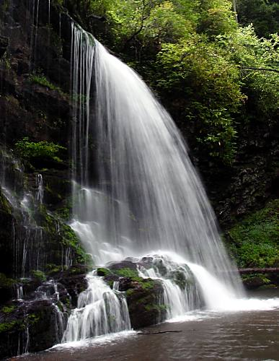
Three major program functions:
Inventory
- high quality natural communities
- rare species locations
significant natural areas
wildlife habitats
Share the Information
Support Conservation
Notes:
NC NHP has more than 20,000 records on locations of rare species, rare natural communities, and significant natural areas.
Map shows distribution of rare species in NC. Red dots represent federally listed species. Blue are state listed and natural communities.
Concentrations of rare species indicates areas of endemism, less disturbance, more natural habitat.

Slide 4
DENR Climate Change Strategic Plan
Goal:
Address climate change in a comprehensive way, using mitigation and adaptation strategies to increase resilience of North Carolina’s resources to these complex changes.
Notes:
READ ALOUD!
Mitigation Strategies: Reduce Greenhouse Gas contributions to climate change.
Adaptation Strategies: Proactively prepare for and adapt to changes we can’t prevent.

Slide 5
NC DENR Climate Change Initiative Overview
Mitigation Strategies: Reduce Greenhouse Gas contributions to climate change. | Adaptation Strategies: Proactively prepare for and adapt to changes we can’t prevent.
Mitigation Sectors Greenhouse Gas Emissions Regulation and Tracking Greenhouse Gas Emissions Reduction Green Energy Development Carbon Sequestration | Adaptation Sectors Sea Level Rise Adaptation Climate-Sensitive Ecosystems Water Management Public Health Impacts Emergency Management Preparedness Land Use Planning and Development

Slide 6
Climate-Sensitive Ecosystems
6-A-1: Develop detailed ecosystem risk assessment
6-A-2: Identify high-risk species and ecosystems; work toward predicting changes in habitat types and extent.
6-A-3: Identify practices to enhance resilience
6-A-4: Identify priority conservation areas and corridors.
6-A-5: Avoid adverse effects on biodiversity from human responses to climate change

Slide 7
Other Vulnerability Assessments
NatureServe Climate Change
Vulnerability Index
Application for select species
Based on Climate Wizard data
Predicts whether a species will decline, remain stable, or increase
Identifies factors causing vulnerability

Slide 8
NHP Vulnerability Assessment and Approach
Hierarchical approach
Assessment by expert panel of biologists
Initial structure and draft worked out by NHP staff
Review and input by partners and other participants

Slide 9
Hierarchical Approach
Broad ecosystem units
Intermediate level systems
Species level
= Ecosystem Groups
= Natural Community types, Animal Habitat Guilds
= rare species and WAP priority species
Notes:
The idea is that most climate change effects and responses can be assumed and applied at the highest hierarchical level and trickled down to communities and species. If there are predicted differing responses, those are recorded as such.
Rare species includes Terrestrial & Aquatic animals and Plants

Slide 10
Guiding Principles
Work with uncertainty.
Generalize from the limited detailed data on particular effects.
Apply ecological common sense in the absence of fine scale information.
Remember complexity and potential for varied responses.
Indicate uncertainty and qualifications.
Notes:
Look at mid range climate predictions but also look at reasonable range of predictions and possible scenarios.
Don’t spend effort on more detail than can be reasonably accurate.

Slide 11
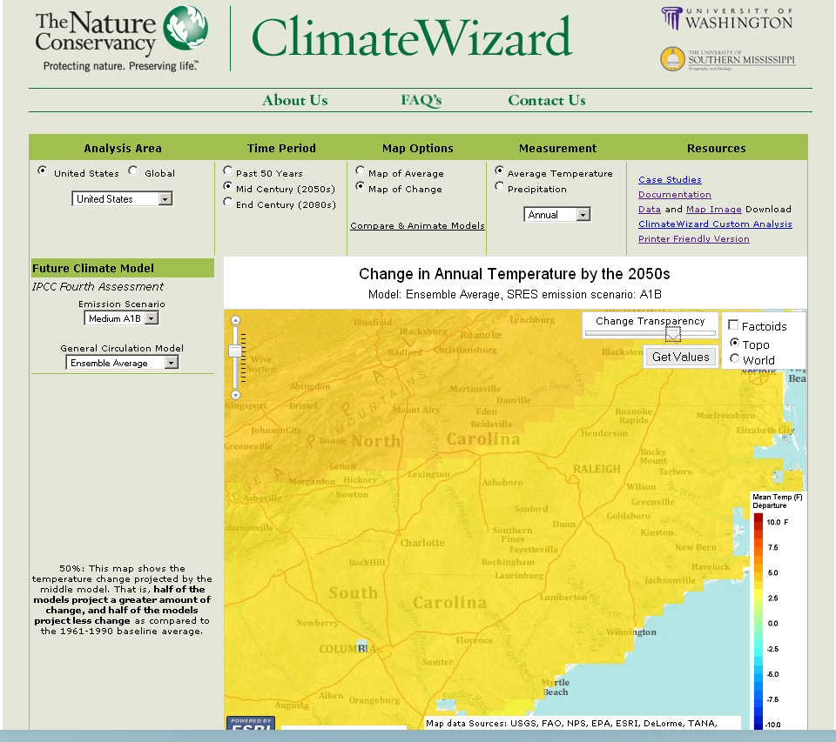
Climate Data
www.climatewizard.org
Notes:
We used Mid-century models (2050), medium emissions scenario model ensemble.
General expectations are
increased temperature: range of 2-6 degrees
Change in distribution of precipitation: more droughts, more floods, severe storms-increased wind damage, etc.
SLR-increased inundation, salt water intrusion

Slide 12
Methods
Compile list of physical and biological changes that can be expected.
Estimate the possible effects of climate change.
Estimate possible ecosystem, habitat, and species responses (good or bad).
Rank climate change threats in comparison to other threats.
Recommend adaptation strategies.
Identify conservation priorities.

Slide 13
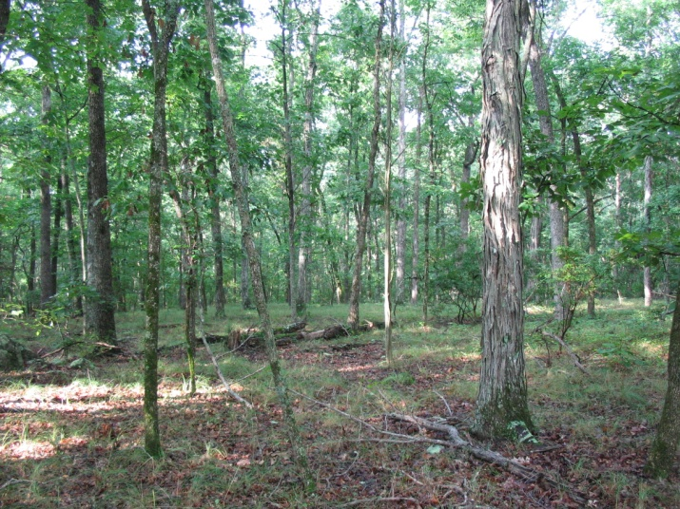
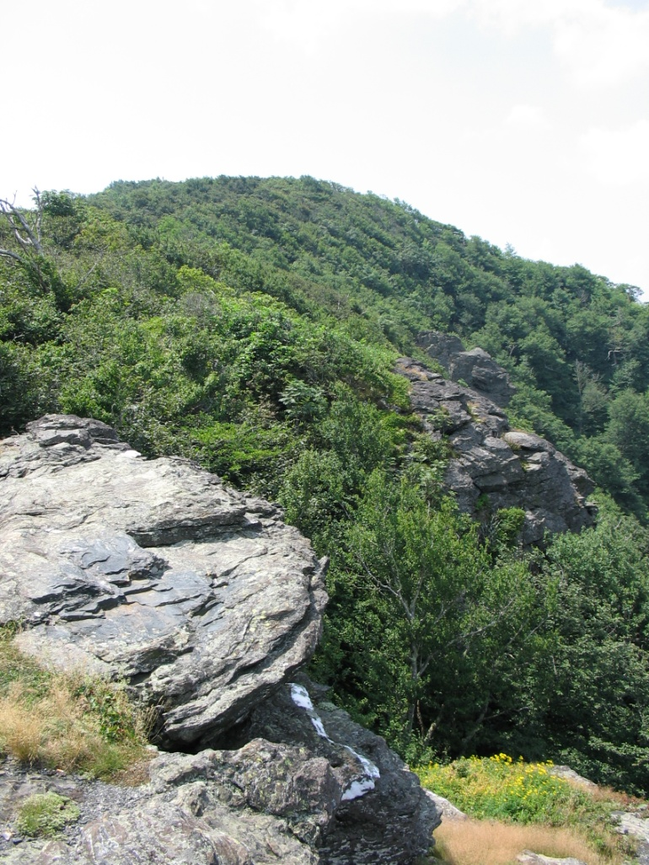
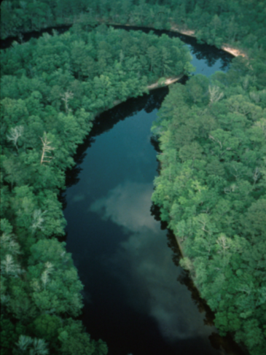
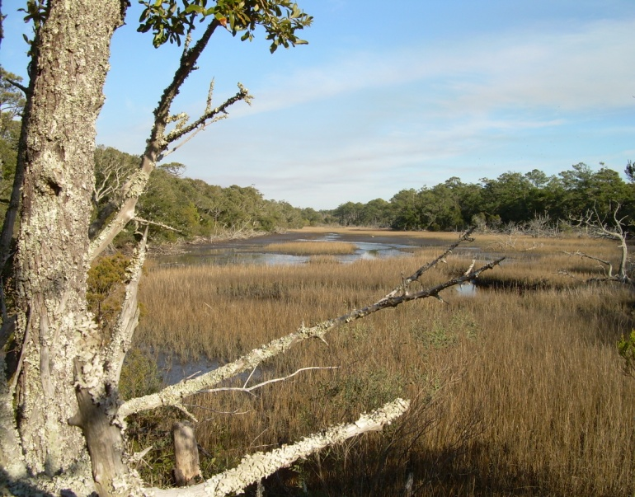
42 Ecosystem Groups
Terrestrial, Aquatic, and Successional communities

Slide 14
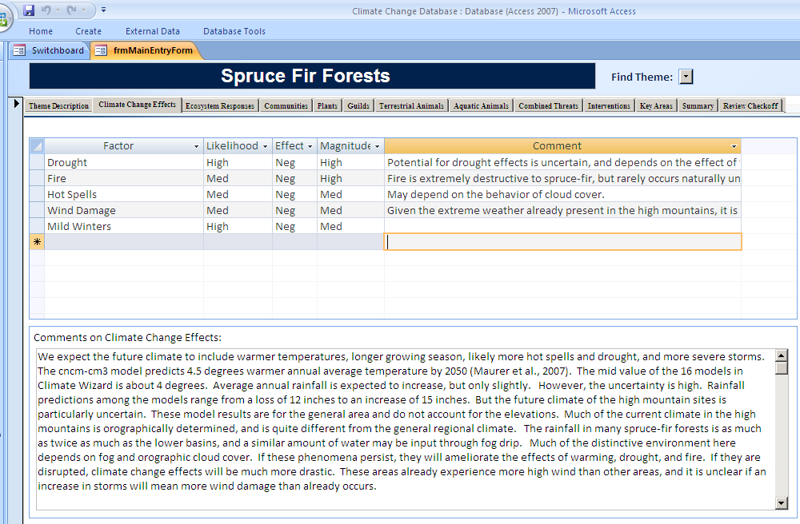

Slide 15
Spruce-Fir Forests
Predicted Climate Change Effects
Drought
Mild Winters
Hot Spells
Wild Fire
Wind damage
Notes:
Notes: This is one of MOST threatened by Climate Change
-Drought, mild winters, hot spells could lead to mortality of some species (canopy trees or other dominant species)
-Spruce have been demonstrated to be subject to physiological temperature disruption such as premature breaking of winter dormancy and even cambium mortality from sun shining on their trunks.
-If fog is reduced, loss of moist sub-canopy microclimate and wet bryophyte layers may threaten many species even without mortality of trees.
-Mild winters could lead to invasion of species from lower elevations or increased exotic species invasion.
-Drought and warmer temperatures may accelerate organic matter decomposition, reducing soil organic layer and threatening moist soil and litter species.
-Fire would likely be catastrophic. Spruce-fir forests are not adapted to fire.

Slide 16
Spruce-Fir Forests
Ecosystem Level Response
Elevation change/ reduction in size
Increased fragmentation
Change in composition
Change in structure
Increased exotic species invasion

Slide 17
Spruce-Fir Forests
Community Level Response
Fraser-Fir Forests
Occur only at highest part of highest peaks
Will shrink drastically and may disappear entirely
Spruce-Fir Forests
Will become restricted to higher elevations and smaller areas
Less likely to be totally eliminated

Slide 18
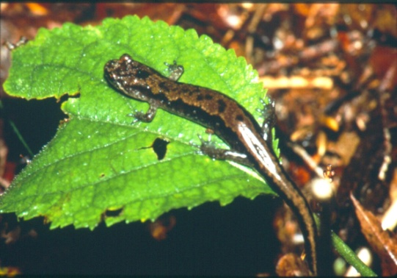
Spruce-Fir Forests
Species Level Response
Many endemic or highly disjunct
Many depend on cool, moist microclimates
Some particularly susceptible to desiccation
Examples: Spruce-fir moss spider, salamanders, Fraser Fir,
other Bryophytes
Dusky Salamander
Green Comma

Slide 19
Spruce-Fir Forests
Combined Threats
Threat
Climate Change
Invasive Species
Air Pollution
Wild Fire
Development
Logging/Exploitation
Rank
1
1
1
2
3
4
Notes:
Climate Change, Invasive Species (Adelgid), and Air pollution are tied for most severe threat.

Slide 20
Spruce-Fir Forests
Adaptation strategies
Control Invasive Species
Protect from Wildfire
Protect or Expand Remaining Examples
Restore Extirpated Areas
Restore/Maintain Landscape Connections
Reintroduce Species

Slide 21
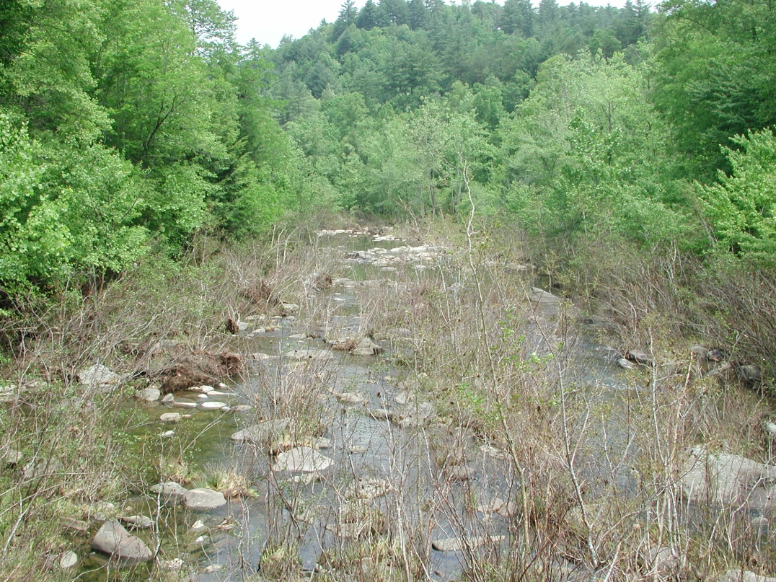
Piedmont & Mountain Floodplains
Predicted Climate Change Effects
Flooding
Mild winters
Drought
Notes:
General forecasts suggest an increase in severe storms and in droughts. This may cause more wind damage to canopy trees.
Drought and increased thunderstorm intensity are likely to produce more wild fires—which might actually be good for these systems. However, wild fires in drought may be more likely to be too intense or too extensive, and could harm some species. In small, isolated sites, an increase in wildfires may have catastrophic impacts on insects and other animals that depend on a metapopulation strategy for coping with environmental disturbances. For such species, landscape connectivity is critical to get to unburned refuges. As a result, there may be a significant increase in local extirpations.
Mild winters, with decreased cold damage, are likely to allow species from the south to move into North Carolina. In recent years, several longleaf-pine associated insects once thought to be restricted to Florida or the Gulf Coast have been found to be established in North Carolina. Although we lack the historic data to know for sure that these represent recent colonizations, this trend will undoubtedly accelerate with decreasingly cold winters.

Slide 22
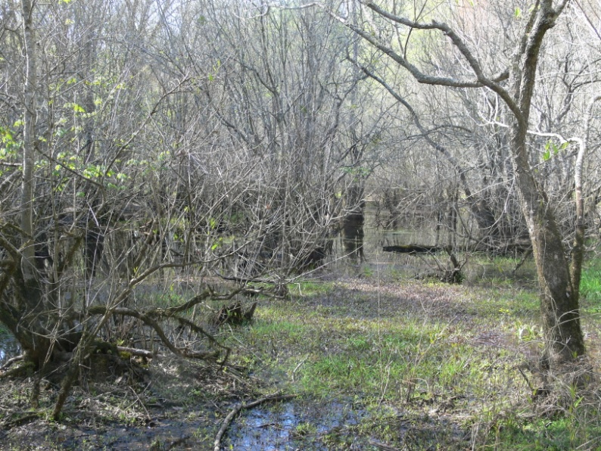
Piedmont & Mountain Floodplains
Ecosystem Level Response
Invasive species
Change in structure
Change in composition
Slight increase in extent with deeper floods

Slide 23
Piedmont & Mountain Floodplains
Community Level Response
Piedmont/Mountain Levee Forest
Piedmont/Mountain Bottomland Forest
Piedmont/Low Mountain Alluvial Forest
Montane Alluvial Forest
Sand and Mud Bar
Rocky Bar and Shore
Piedmont/Mountain Semipermanent Impoundment
Floodplain Pool
Many communities already frequently disturbed
Potential for increased flood scouring and channel migration
Severe effects will likely be small in scope

Slide 24
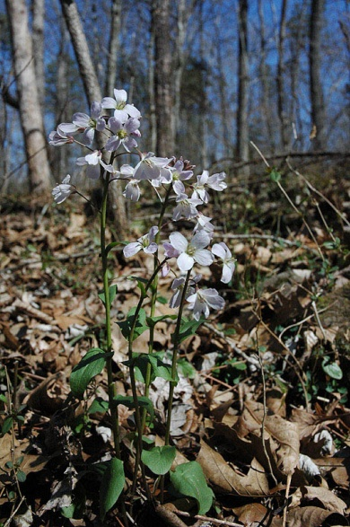
Piedmont & Mountain Floodplains
Species Level Response
Most floodplain plants and animals are common
Few rare species may be vulnerable to significant changes in hydrology
Few rare, endemic Lepidopterans
Virginia Spiraea
Douglass’s Bittercress

Slide 25
Piedmont & Mountain Floodplains
Combined Threats
Threat
Logging
Development
Invasive Species
Flood Regime Alteration
Groundwater Depletion
Climate Change
Rank
1
2
3
4
5
6

Slide 26
Piedmont & Mountain Floodplains
Adaptation strategies
Restore or maintain landscape connections
Restore or maintain hydrology
Protect or expand remaining examples
Control invasive species
Notes:
Landscape corridors: designing bridge crossings for wildlife movement

Slide 27
Ecosystem Groups most threatened by Climate Change
Coastal Plain
Coastal Plain Nonalluvial Mineral Wetlands
Estuarine Communities
Freshwater Tidal Wetlands
Maritime Grasslands
Maritime Upland Forests
Maritime Wetland Forests
Notes:
These are ecosystem groups with a climate change rank of 1.

Slide 28
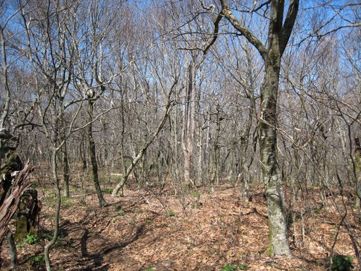
Ecosystem Groups most threatened by Climate Change
Mountains and Piedmont
High Elevation Rock Outcrops
Northern Hardwood Forests
Spruce Fir Forests
Upland Seepages and Spray Cliffs
Notes:
These are ecosystem groups with a climate change rank of 1.

Slide 29
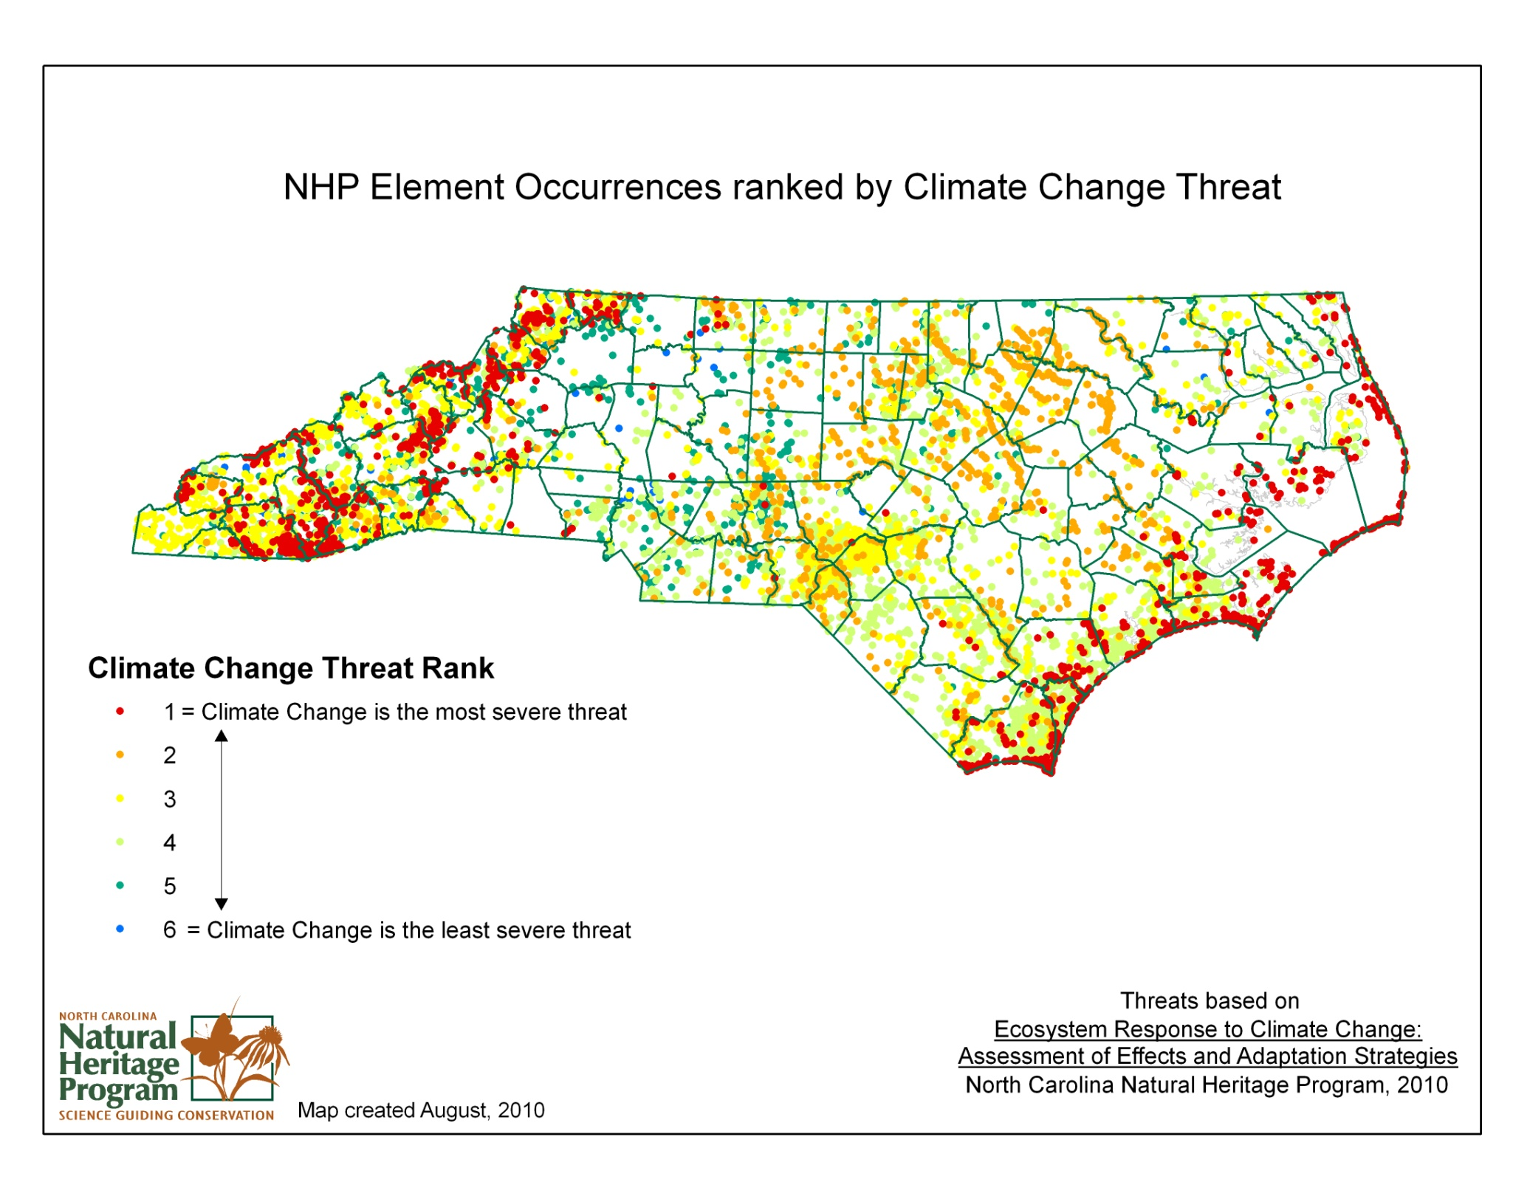

Slide 30
Take Home Messages
Identifies not just vulnerable habitats, but also those with resilience
We shouldn’t abandon highly threatened ecosystems, habitats, or species
Recommended Interventions are things we should be doing anyway
Climate Change is not the only threat
Notes:
-Don’t abandon highly threatened places: suggested interventions that will help increase resiliency; if we do a good job at these sites, they will be able to adapt and we may not lose all of them.
Interventions-things we should be doing already and We know how to do most of them.
-Climate Change is not only threat: in some cases it is not the biggest threat and we can’t lose sight of other issues we’re already dealing with.

Slide 31
Opportunity for Collaboration and Partnership
Draft reports for all Ecosystems
can be viewed online.
www.climatechange.nc.gov

Slide 32
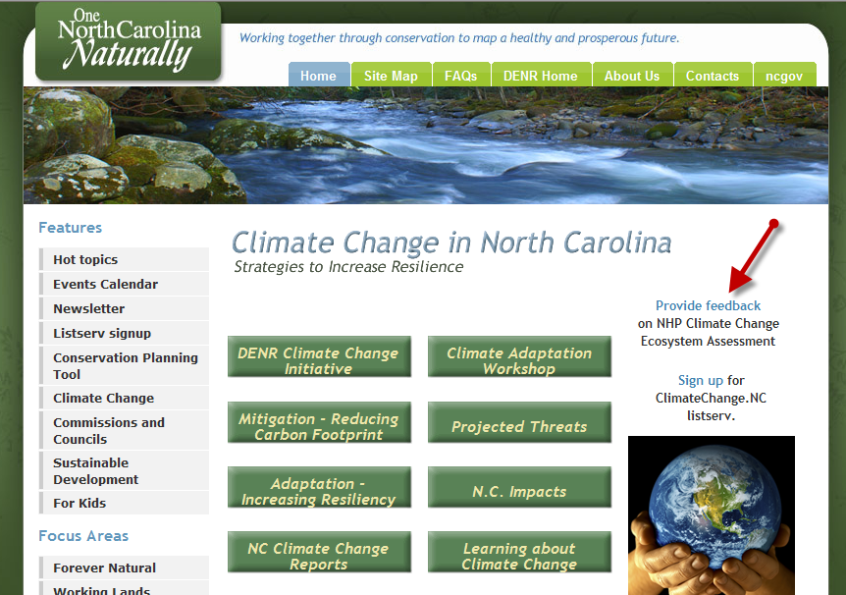

Slide 33
Questions?

