Slide 1
25 Years of SAMAB Cooperative Accomplishments Jennifer Thomsen Clemson University

Slide 2
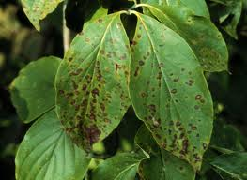
Dogwood Anthracnose Workshop and Education Materials
1990
Developed educational programs and materials for schools and the public for dogwood anthracnose and conducted two workshops for the public.

Slide 3
Air Quality Forums and Planning
1992
SAMAB sponsored two symposiums for air quality management and SAMAB appointed a committee to develop and coordinate a strategic plan for air quality monitoring and research in the region.

Slide 4
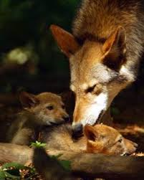
“Front Runner” documentary of reintroduction of the Red Wolf
1992-1993
SAMAB sponsored the award-winning television program, a quarterly newsletter, and educational materials that coordinated with the program that were distributed classrooms around the region.
The documentary also received an Emmy Award for its excellence.

Slide 5
Forest Monitoring Component of EPA’s Environmental Monitoring Assessment Program (EMAP)
1993
Early in its career, SAMAB acted as the coordinating agency for the monitoring program that measured variables sensitive to ecological change in the Southern Appalachians.

Slide 6
Pittman Center Sustainable Development Study
1993
A study to demonstrate strategies for sustainable development in communities with tourism-based economies and then expanded to more communities in the broader Southern Appalachia.
Program was completed and 500 copies of publication were printed and distributed.
The study was used by communities in West Virginia, Kentucky, and other states.

Slide 7
White House Ecosystem Task Force Review of SAMAB
1994
SAMAB was selected as one of several case studies to be reviewed by the White House Ecosystem Task Force to highlight successful templates for ecosystem management.

Slide 8
Hubert Hinote Award
1995
An award was established in honor of the first executive director of SAMAB, Hubert Hinote, for personal dedication to SAMAB.

Slide 9
Southern Appalachian Assessment (SAA)
1996
Collected and coordinated terrestrial, aquatic, atmospheric, and social, cultural, economic data for the Southern Appalachian region; published five reports and created a database for GIS and files.

Slide 10
Recipient of the USDA Forest Service Ecosystem Management Award
1996
SAMAB received award from the Chief of the USDA around the time the Southern Appalachian Assessment was completed.

Slide 11
Integration of Human Health and Natural Resources Workshop
1997
The workshop’s attendance represented more than 35 different disciplines and affiliations and aimed at determining how research and management disciplines used in natural resources and human health could be integrated to reach the goal of sustainability.

Slide 12
Recipient for National Performance Review’s Hammer Award
1997
Received the Hammer Award for efficiency in government through the completion of the Southern Appalachian Assessment.

Slide 13
Sustainable Communities Initiative
1997-1998
A workshop explored measures of change and community development indicators that were meaningful to people of the region.
The project provided a tool for individuals, government planning units, and non-profit organizations to explore and apply the extensive data compiled from the SAA.

Slide 14
Book published entitled Ecosystem Management for Sustainability: Principles and Practices Illustrated by a Regional Biosphere Cooperative
1999
Edited by John Peine, a former SAMAB Cooperative member, the book highlights the efforts of the SAMAB Cooperative and the challenges facing the region.
It includes contributions by several SAMAB organizations and participants.
Proceeds from book went to SAMAB Foundation.

Slide 15
Southern Appalachian Regional Information System (SARIS)
2000
Taken information from the SAA and established to improve access to spatial data and to facilitate communication about the state of the region’s natural resources.

Slide 16
Southern Appalachian Mountain Initiative (SAMI)
1992-2002
SAMAB played a key role in the development and implementation of the SAMI program which was a ten year effort to describe and predict the effects of air pollution on air quality in eight states abutting the Southern Appalachians.

Slide 17
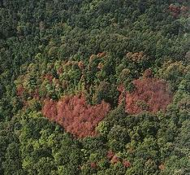
Southern Pine Beetle Workshop
2003-2004
SAMAB sponsored a workshop that was attended by more than 85 managers and researchers to address concerns for the impacts of the southern pine beetle and strategies for future planning.

Slide 18
Citizen Environmental Monitoring Program
2004-2005
12 communities monitored watershed health, invasive species, and forest health to gather information for research and local decision-making.
This also included the production of pocket guides to identify common invasive plants.

Slide 19
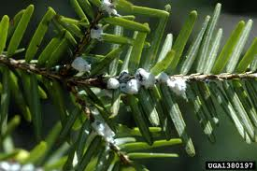
Saving our Hemlocks
2005
The SAMAB-led partnership produced an educational pamphlet and distributed more than 5,000 copies and helped to update the Save Our Hemlocks website for private land and homeowners.
Developed guidance on biological and chemical HWA controls suitable for public and private lands through a HWA poster and supported early efforts to get media coverage of HWA.

Slide 20
Invasive Species Control and Awareness
2006
Continuing as a leader in monitoring invasive plants, SAMAB held a workshop to identify, improve, and develop detection tools for region-wide invasive control
A guide was produced on the Exotic Invasive Plants of Southern Appalachia.

Slide 21
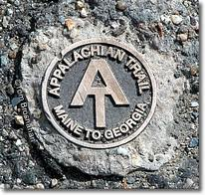
Appalachian Trail Water Quality Teams
2006
Water quality teams were formed to monitor springs and high-value resource waters along the Appalachian Trail.

Slide 22
SAMAB website and newsletter
Throughout
The continuously updated SAMAB website that provides recent news, publications, and other sources of information to the public and the SAMAB newsletter that was sent to an extensive list of members and professionals in the Southern Appalachians.

Slide 23
SAMAB International Relations
Throughout
SAMAB hosted representatives from the World Bank, USAID, IUCN, UNEP, World Wildlife Fund, Poland, Czech and Slovak Republics, India, Russia, Germany, Kenya, Tanzania, Indonesia, Thailand, Korea, and Turkey to demonstrate how the SAMAB model can be transferred to other countries.
SAMAB hosted an international workshop on baseline inventory and monitoring in biosphere reserves, sponsored by USMAB, UNESCO and UNEP.

Slide 24
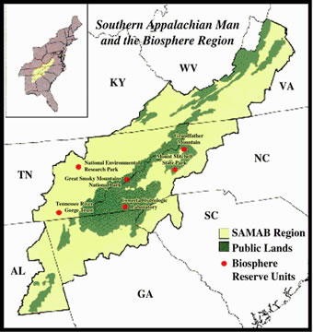
Biosphere reserve partnerships
Throughout
The establishment and cooperation of biosphere reserves in the Southern Appalachian region: Mount Mitchell, GSMNP, Oak Ridge National Laboratory, Coweeta, Grandfather Mountain.

Slide 25
Regional SAMAB Conferences
Throughout
SAMAB has organized 21 successful conferences to bring together diverse stakeholders on a variety of topics addressing social and ecological issues in the Southern Appalachians.
Some example topics:
Relationships of natural resources and economy
Working with communities
Assessing the landscape
Social and economic uses of SA forests

Slide 26
The relationships formed over 25 years of partnerships
Throughout
After 25 years of existence, SAMAB has many intangible successes through the building of personal and professional relationships among SAMAB members throughout the Southern Appalachian region that cross political and institutional boundaries.

